Slide 1
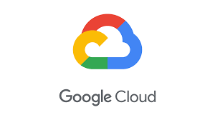
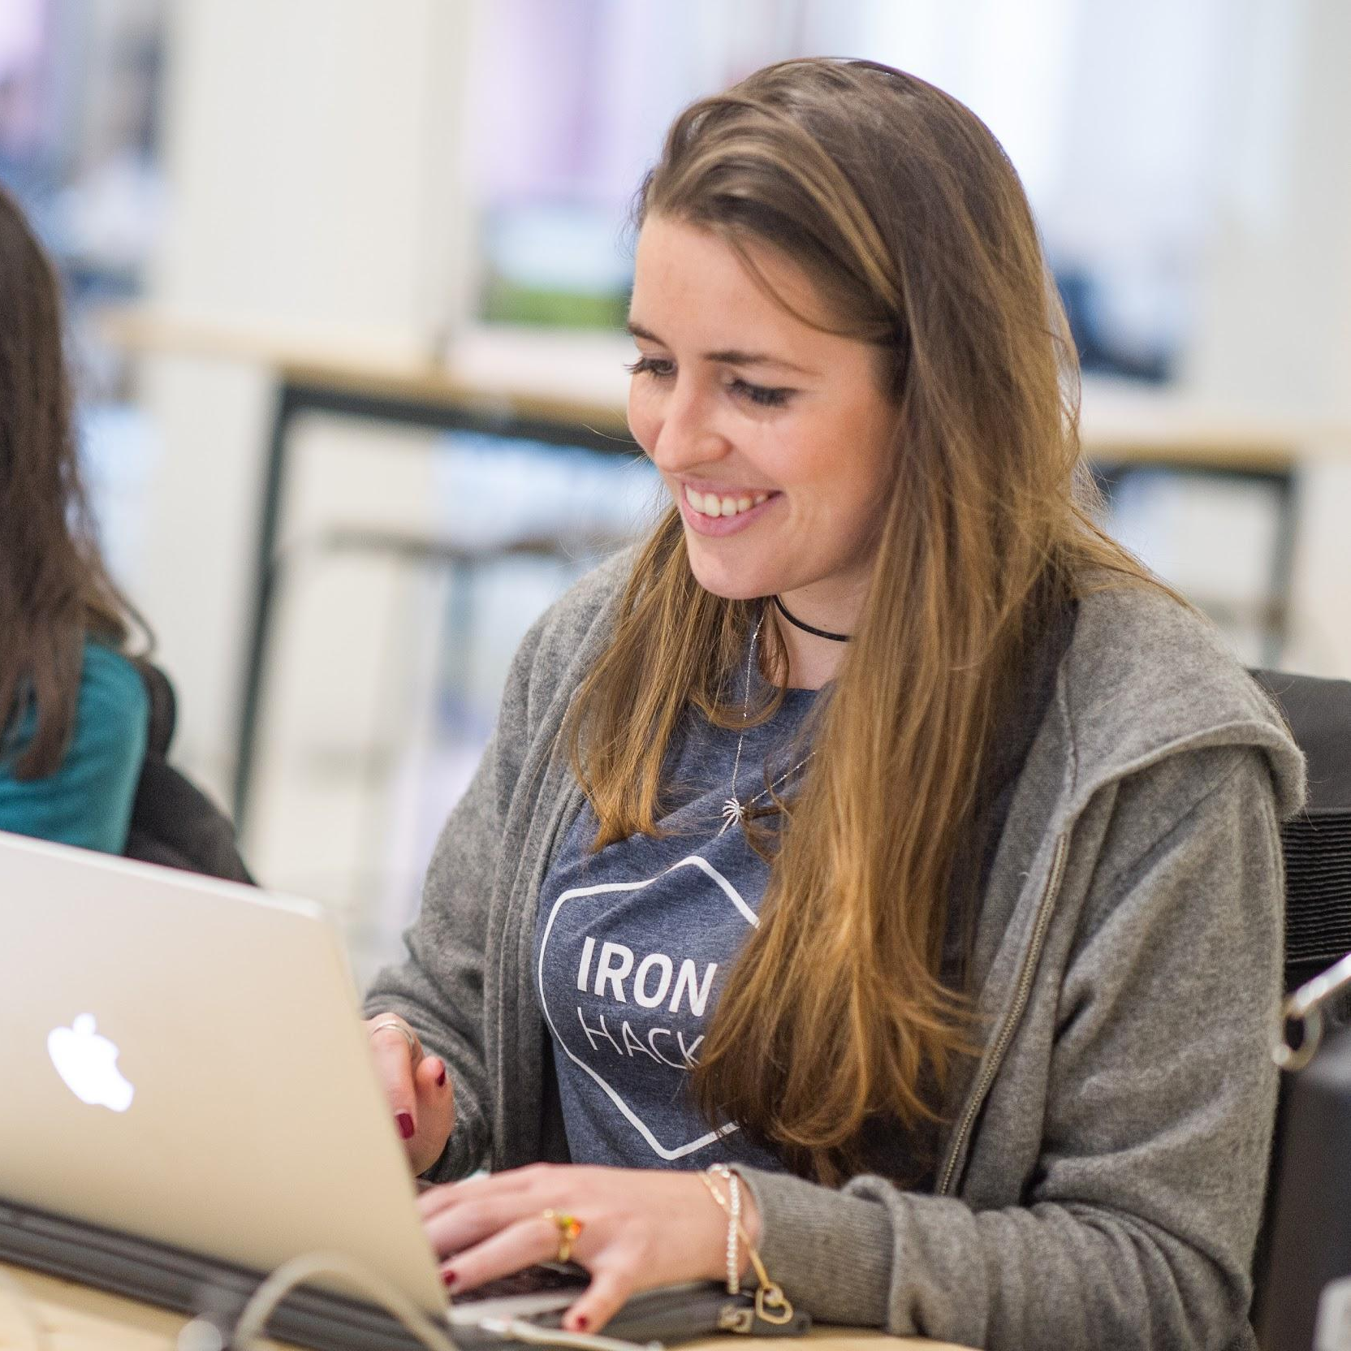
Intro to GCP
DA_FT BERLIN | IRONHACK

Slide 2
Understanding the Cloud
As we saw in Week 8, Cloud computing is the delivery of IT services, such as computing power, database storage, networking, software and analytics over the Internet ("the cloud")
Instead of buying, owning, and maintaining physical data centers and servers, companies can obtain technology services from a third-party provider

Slide 3
WHY GCP?
Google Cloud Platform (GCP) is a suite of cloud computing services that run on the same infrastructure that Google uses internally for its end-user products (YouTube, Gmail, and Google Maps)
GCP offers a broad range of globally distributed cloud computing services including computing, data storage, data analytics, machine learning, and network services.

Slide 4
Key GCP features
Global Infrastructure: Extensive network of data centers worldwide for low latency and high availability.
Advanced Data Analytics and Machine Learning: Leveraging Google's expertise in these areas, GCP offers powerful tools like BigQuery and TensorFlow.
Openness and Interoperability: Works seamlessly with other cloud platforms and on-premises systems.
Strong Security and Compliance: Built-in security features and certifications to protect your data.

Slide 5
GCP building blocks
Compute Engine: Create and manage custom virtual machines (VMs) to run your applications.
App Engine: Develop and host scalable applications without worrying about the underlying
infrastructure.
Cloud Storage: Store and manage vast amounts of data in a durable and accessible manner.
BigQuery: Analyze petabytes of data with speed and ease, using standard SQL.
Cloud SQL: Host instances of popular relational databases like MySQL, PostgreSQL, and SQL Server.
Cloud Functions: Execute serverless code in response to events, such as database changes or file uploads.

Slide 6
Real world use cases
E-commerce: Product personalization, real-time sales data analysis, and scalability for peak demand.
Healthcare: Genomic data analysis, development of mobile health applications, and secure storage of patient data.
Finance: Fraud detection, risk analysis, and development of algorithmic trading applications.
Media and Entertainment: Real-time video encoding, global content delivery, and audience data analysis.

Slide 7
Real world use cases
E-commerce: Product personalization, real-time sales data analysis, and scalability for peak demand.
Healthcare: Genomic data analysis, development of mobile health applications, and secure storage of patient data.
Finance: Fraud detection, risk analysis, and development of algorithmic trading applications.
Media and Entertainment: Real-time video encoding, global content delivery, and audience data analysis.

Slide 8
Hands on BigQuery
To begin your GCP journey, you'll need to create a Google Cloud account.
Visit the Google Cloud Platform at: https://cloud.google.com
Click on "Sign In" and use your Google account or create a new one.
You'll be prompted to provide billing information. Don't worry, GCP offers a free tier to explore its services.

Slide 9

Supervised Learning.

Slide 10
Unsupervised Learning.

Slide 11


